Slide 1
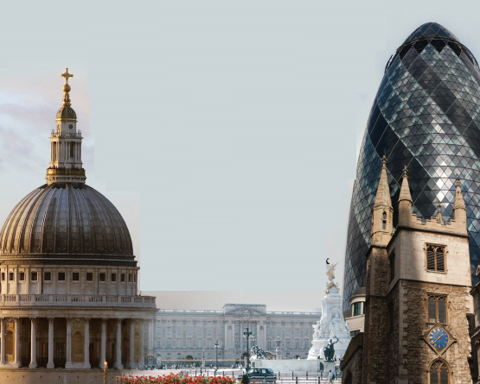
Department of Politics and International Relations
The Democratic Education Network
Field Trip to the City of London: Continuity and Change
Part 2

Slide 2
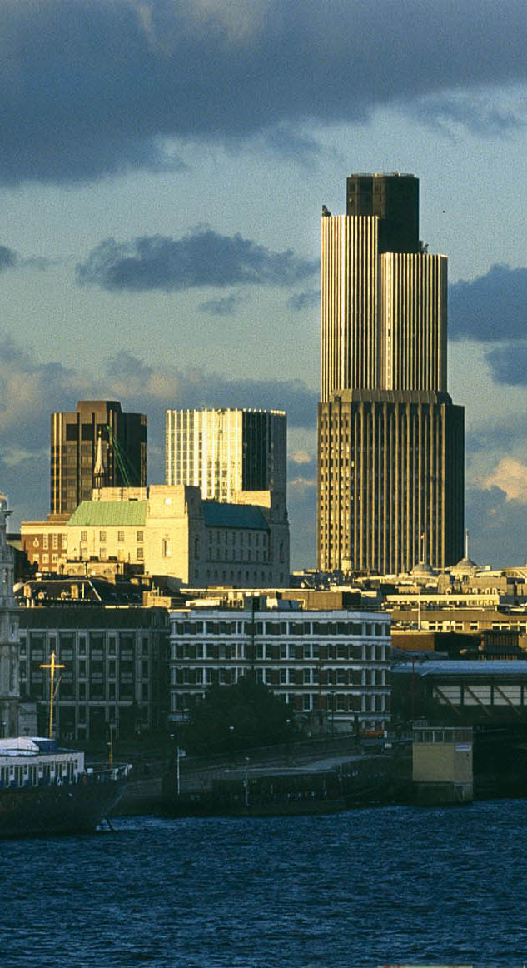
Why City of London?
London is a medieval city
Diverse population speaking over 300 languages.
Its industrialization and capitalist development were crucial for the British empire.
Multinational corporations, such as the East India Company, have played a significant role in the city.
It is a place of migration and has a population of 11,000 residents and 300,000 workers.
It has an independent city hall, police force, and mayor.
Ports and rivers play a vital role in trading.
Lombard Street is home to major banks and insurance companies

Slide 3
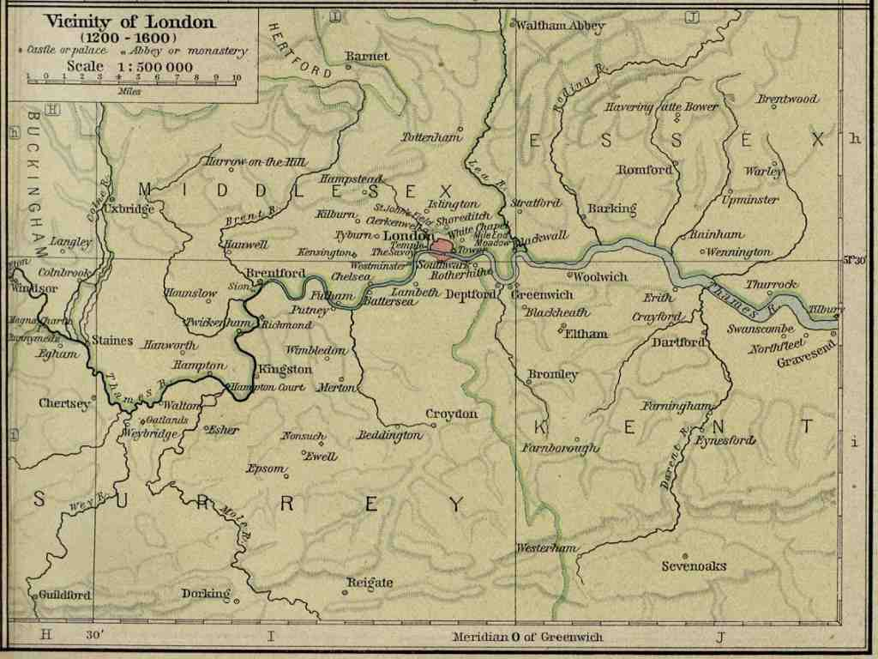
London, England
Founded in 43 AD (“London”439)
Used as trading centre by Romans
Became the capital of England in 978 AD
This map of London illustrates London from 1200- 1600 AD. (Shepard)

Slide 4
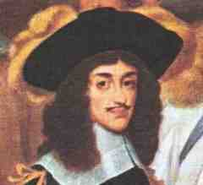
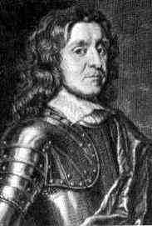
Politics
1625 A.D. Charles I was crowned King of England
Rules without parliament from 1629-1640
Mismanagement of affairs caused conflict and led to civil war (Revolution) outbreaks, followed by his execution in 1649 (“Charles”)
Oliver Cromwell died in 1658
Restoration of Stuart Monarchy begins following death (Plant)
Charles II (“British”)
Oliver Cromwell

Slide 5
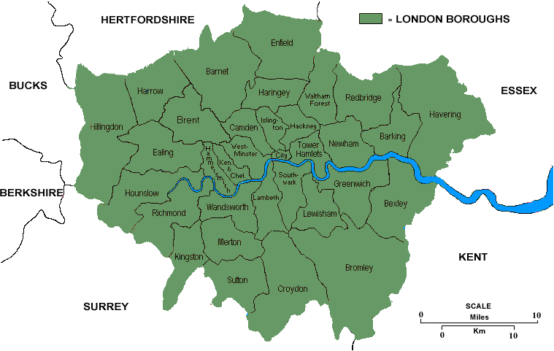
The City in London
Map of London Today

Slide 6
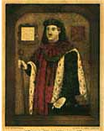
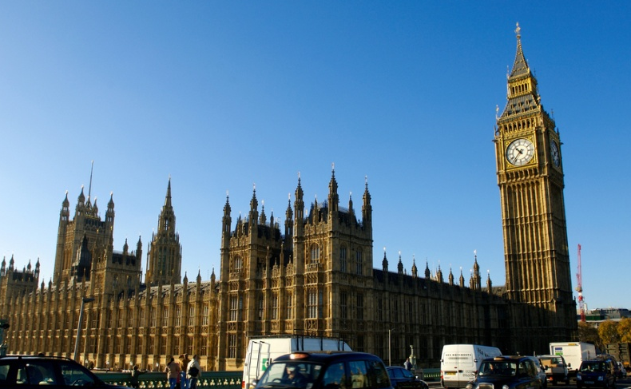

History
The City of London is older than Parliament
Existed for more than 800 years
Important for economic growth
Henry
FitzAilwyn
First Mayor
of London
1189

Slide 7
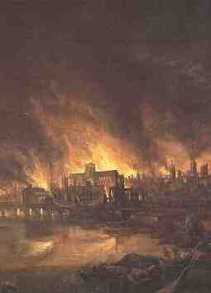
The Monument to the Great Fire of London - 1666
In memory of the Great Fire of London in 1666
The most well know disaster in London’s history
100,000 lost their homes
Destroyed 80% of the city
It took 50 years to rebuild the city
Started in a Bakery nearby
13,200 houses and 87 out of 109 churches were destroyed
St Paul’s Cathedral was ruined
the Guildhall (the offices of the Lord Mayor) survived
52 livery companies:
  Trade and craft associations
  There are 108 livery companies in the City of London

Slide 8
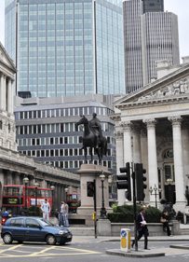
Bank of England
Established in 1694
Made England a global power against its competitor, France
It raised private funds to support the navy to capture attractive areas in the world – colonisation
Together with the navy, this made England major power in the 18th and 19th
Maximum security, such as thick and high walls to prevent thieves. This is why we say, ‘Your money is as safe as the Bank of England’
Gold bullion is still stored in the vaults below
You may return to visit the museum in the bank, in your own time

Slide 9
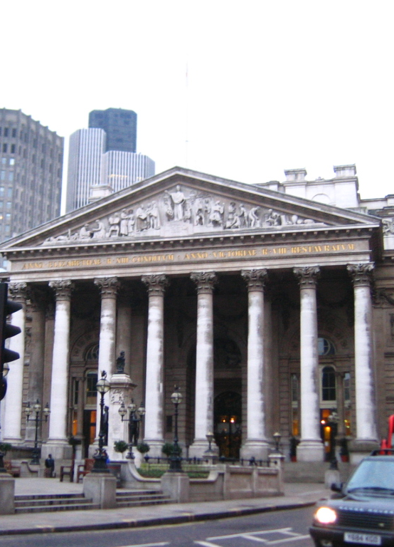
Stock Exchange
Trade in shares and stocks;
Began with financing voyages by different companies e.g. Moscovy Company going to China and East India company’s voyage to India
They covered the cost by raising money through selling shares to merchants
Trading began in 1688
Important during industrialization
Refurbished recently

Slide 10
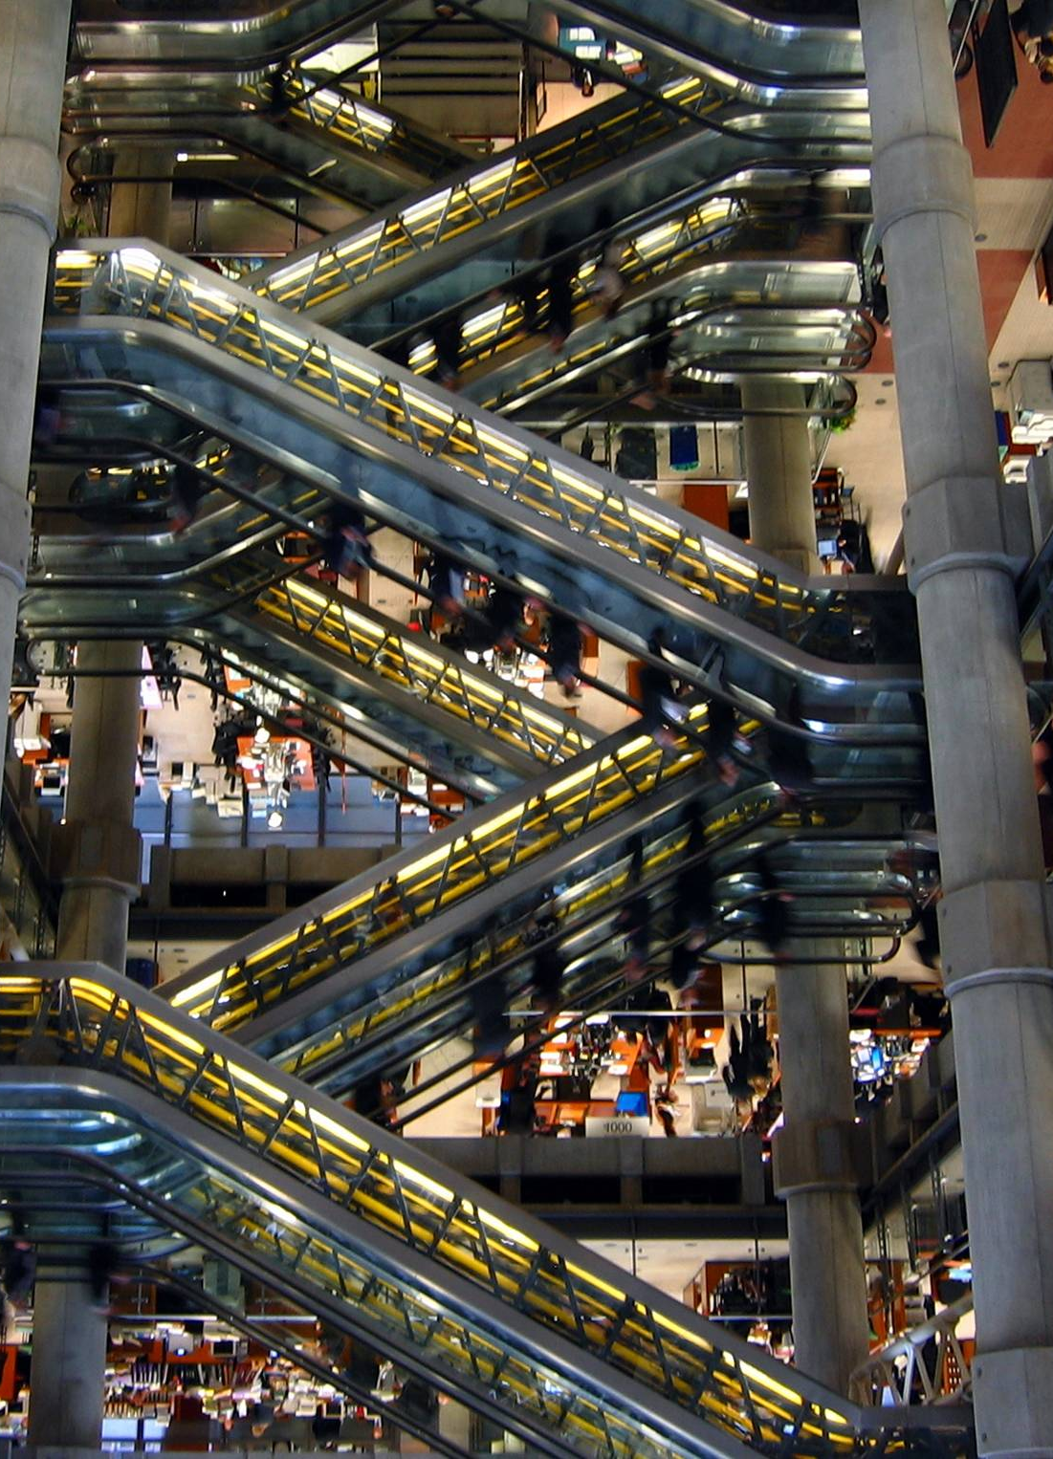
Lloyds of London
British insurance and reinsurance market
In 2009 alone Lloyds transactions of 30bn gross premium
The old building, 1686 a coffee house
Owned by Edward Lloyds
Place for sailors, merchants
Financial bankers also met there to discuss dealings
It provided shipping news
In 1691 the coffee shop was relocated to Lombard Street
Became British insurance company in 1774
It covered insurance for shipping
Insured the ships which involved in slave trade
The new building designed by Richard Rogers in 1986
Known as the Inside Out building as the toilets, lifts, pipe ducts all on the outside instead of hidden inside

Slide 11
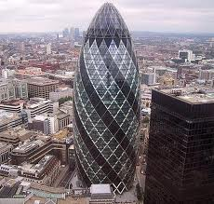
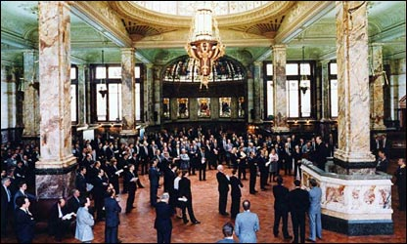
The Baltic Exchange – St Mary Axe (The Gherkin)
Was the Virginia and Maryland coffee house in Threadneedle Street but changed its name to Virginia and Baltick.
The merchants and ship owners usually went there for coffee and tea & business dealings
Centre of world trade
Arranging world transportation and industrial goods from buyers to sellers
Co-operation of shipping and charters for free flow of trade
In 1903 the building moved, from the Baltic to a new purpose built exchange in St Mary Axe
In 1992 a bomb destroyed the Baltic Exchange, trading moved to Lloyd’s of London
In 1995 New building at 30 St Mary Axe

Slide 12
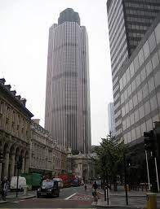
Tower 42
The second tallest skyscraper, 183 meters (600 ft);
Originally built for Nat West
From the air, its design is the old Nat West logo
Designed by Richard Seifert and engineered by Pell Frischmann

Slide 13
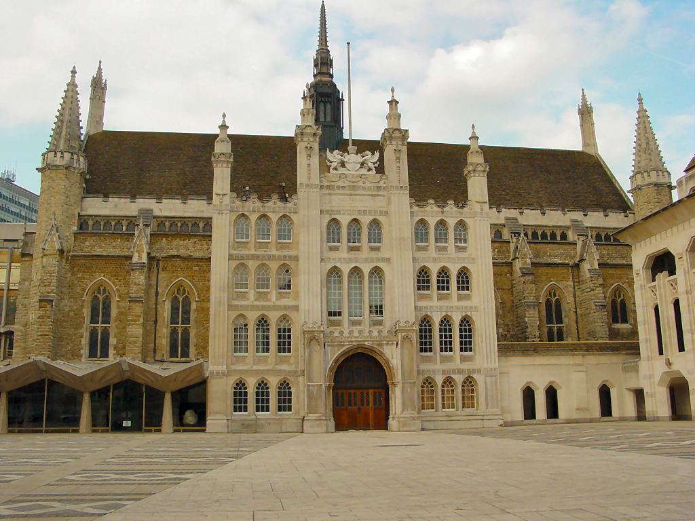
Guildhall
A place where citizens used to pay their taxes
In Roman times was an amphitheatre
Possibly has been there since 1128
Survived the great Fire of London in 1666
It has representatives (see their flags in the hall) of different guilds in the building
Now a town hall, administration for the City of London
Relatively independent & has its own budget
Hosts events such as Lord Mayor’s Banquet where the Prime Minister annually makes a major speech on global political economy

Slide 14
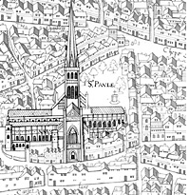
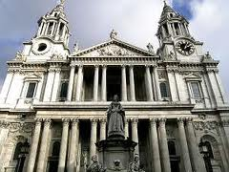
St Paul's Cathedral
Founded in 604 by Bishop Mellitus
Dedicated to St Paul in London
Destroyed by fire in 1087
A new cathedral completed in the 1320s
Was the largest building in England

Slide 15
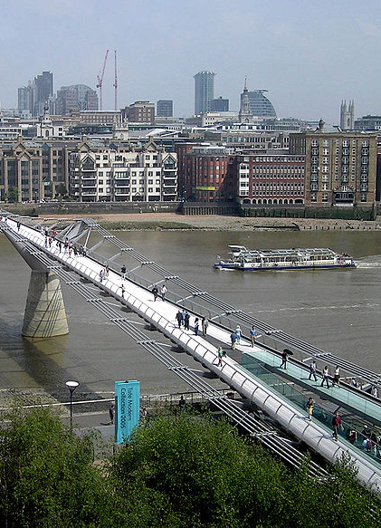
Millennium Bridge
Opened in 2000
Connects the city of London to the South
‘Wobbly Bridge’ – swaying motion when it was first opened
Altered and re-opened in 2002

Slide 16
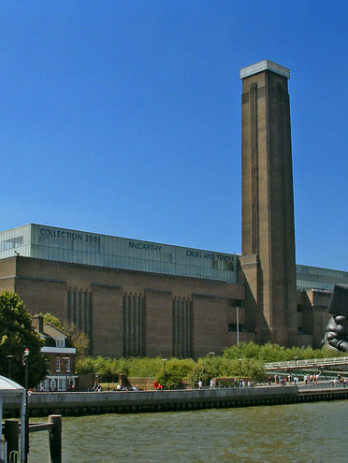
Tate Modern
An art gallery
But it used to be a power station
The power station was closed in 1981
Re-opened in 2000

Slide 17
What have we learnt?
Continuity and change, past and present, convergence and divergence
Colonialism, Feudalism, slavery, capitalism, globalisation, localisation and . . .
International migration past and present
Centre of stability and instability
Any thing else?

Slide 18
Readings
Clout, H. (2004), The Times History of London: An Outstanding Illustrated Survey of One of the World's Greatest Cities, London: Times Books.
Clark, J. & Ross, K. (2004), London: The Illustrated History, London: Allen Lane
Massey, D. B. (2007). World City. London: Sage
http://www.cityoflondon.gov.uk/Corporation/homepage.htm
http://www.museumoflondon.org.uk/Explore-online/Pocket-histories/where-do-londoners-come-from/
http://www.cityoflondon.gov.uk/Corporation/homepage.htm
http://www.lwbooks.co.uk/journals/soundings/articles/06%20s32%20massey.pdf

