Slide 1
DEN 2024 Field Trip
Welcome to the University of Westminster
College of Liberal Arts and Science
School of Social Science

Slide 2
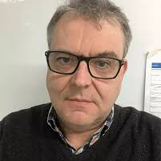


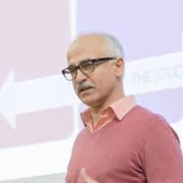
Alan Porter Prof Dibyesh Anand Dr Thomas Moore Dr Farhang Morady

Slide 3
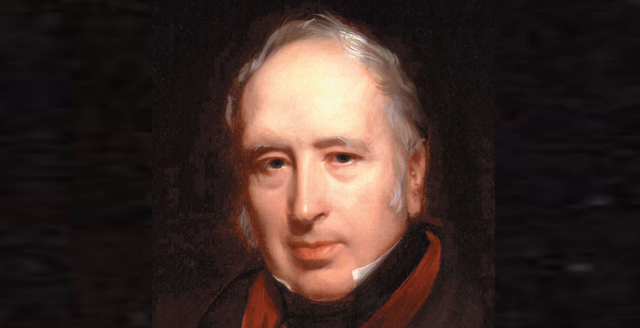
Sir George Cayley (1773-1857)
Inventor
Engineer
Aviator

Slide 4
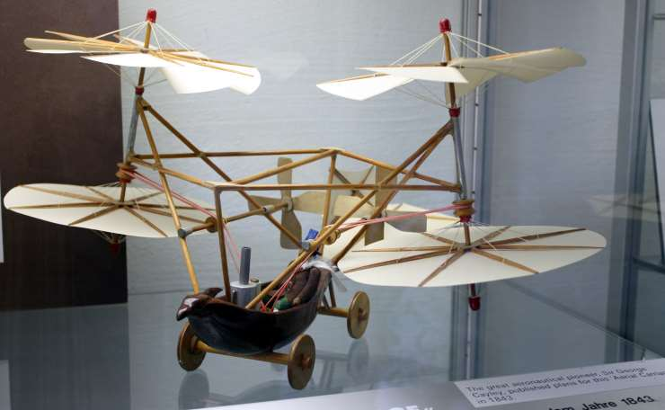
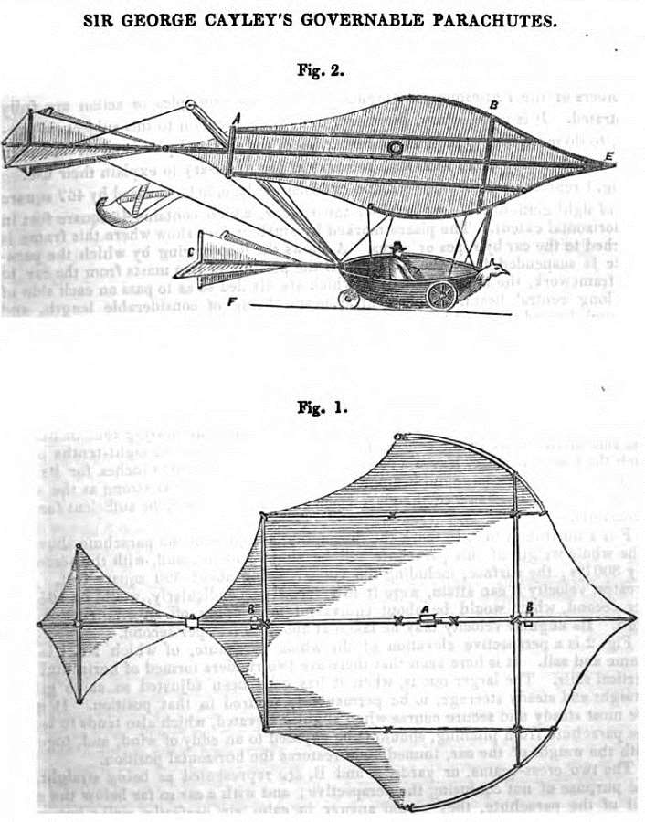
Notes:
https://www.historic-uk.com/HistoryUK/HistoryofBritain/Sir-George-Cayley/

Slide 5
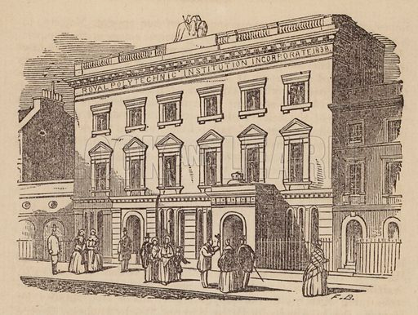
The Polytechnic Institution
309 Regent Street
1838–1881
Present new inventions and scientific discoveries to the general public
Notes:
Royal Polytechnic Institution, 309, Regent Street, near Portland Place. Illustration for London As It Is To-Day (H G Clarke, 1856).

Slide 6
The Polytechnic Institution
309 Regent Street
1838–1881
Present new inventions and scientific discoveries to the general public
1843 catalogue
Beatson's Scarifier
Smith's Sub-soil Plough
Improved Sluice-Cock
Morton's Revolving Harrow with Extirpator
Bone-Crusher with Double Rollers.
Notes:
Royal Polytechnic Institution, 309, Regent Street, near Portland Place. Illustration for London As It Is To-Day (H G Clarke, 1856).

Slide 7
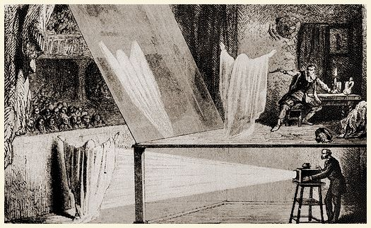
Director of the Polytechnic, Professor John Pepper develop the popular theatrical illusion known as Pepper's Ghost.

Slide 8
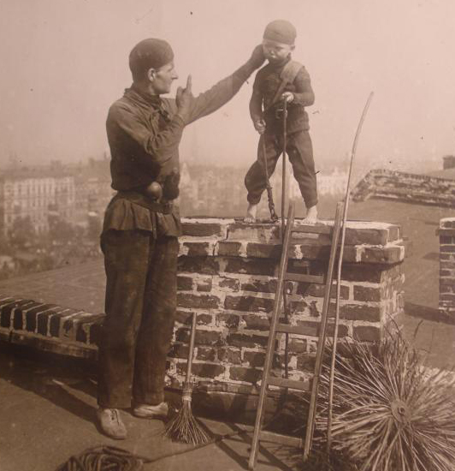
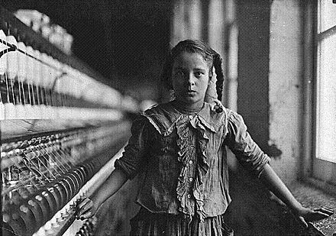
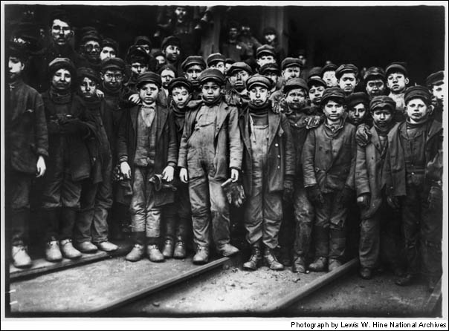
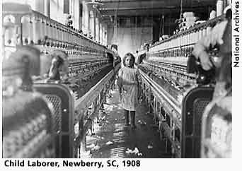
1870 The Education Act requires the establishment of non-denominational schools
1880 Attendance is made compulsory until the age of 10
1891 Elementary education effectively becomes free
1918 Leaving age is raised to 14

Slide 9
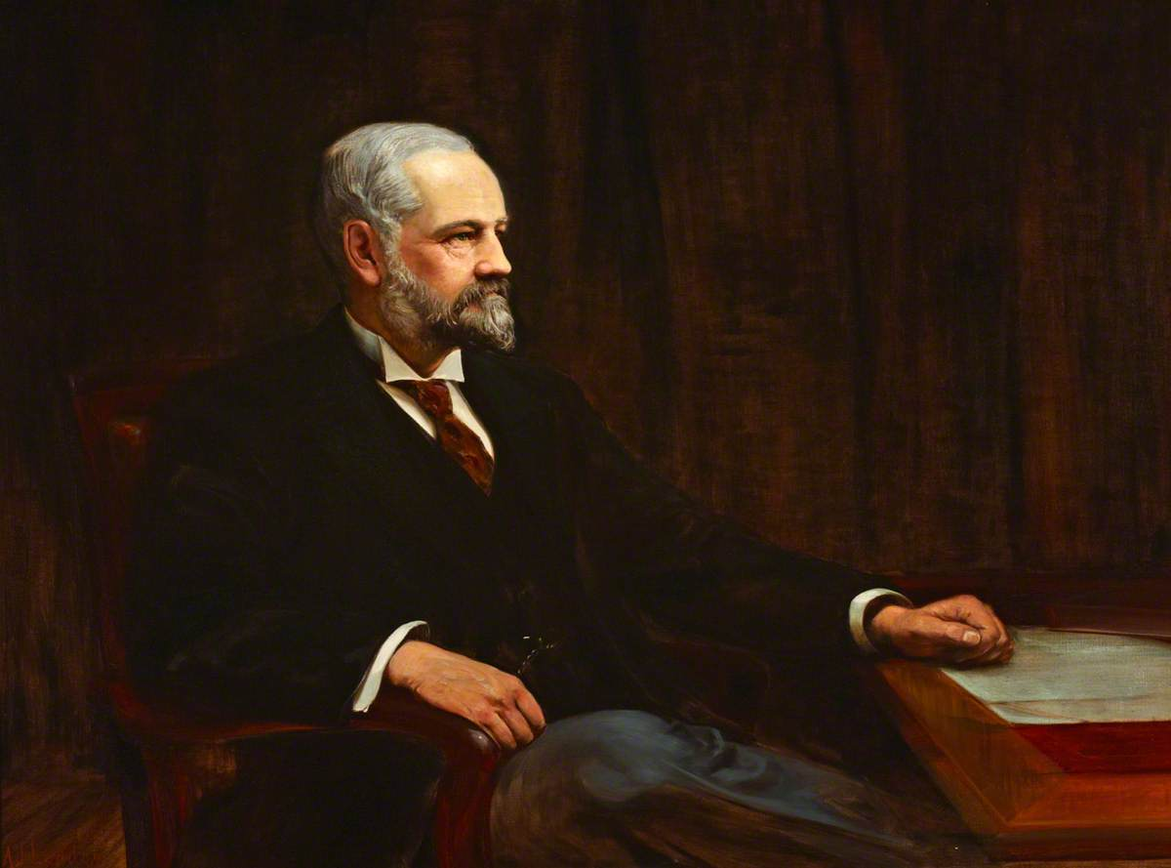
Quintin Hogg (1845–1903) 1891-1970 Regent Street Polytechnic
Notes:
Quintin Hogg (1845–1903), Founder of the Regent Street Polytechnic
Albert James Lyddon (1872–1945)
https://artuk.org/discover/artworks/quintin-hogg-18451903-founder-of-the-regent-street-polytechnic-194441

Slide 10
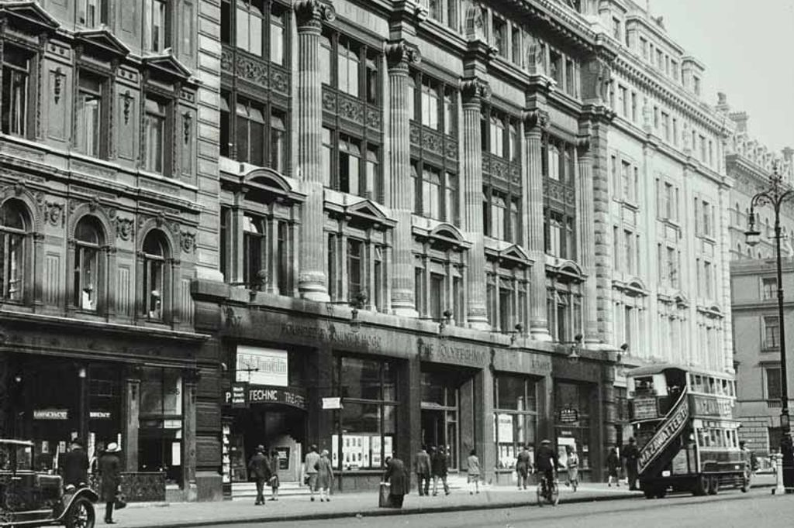
1864 he founded York Place Ragged School
Polytechnic Young Men's Christian
Technical and commercial subjects for education of young men from the working classes
1964 began awarding degrees
Notes:
https://layersoflondon.humap.site/map/records/regent-street-polytechnic-c-1920

Slide 11
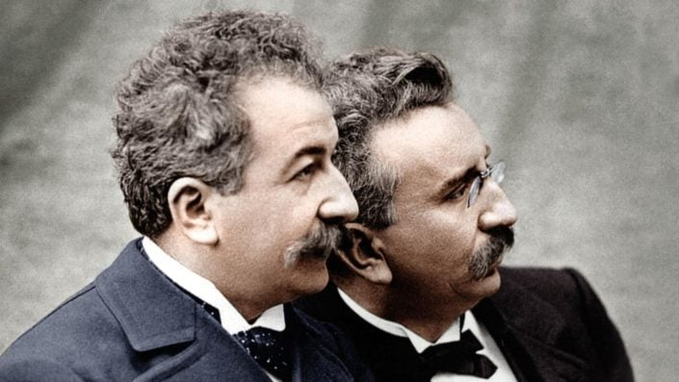
1896 the Lumière Brothers made the first presentation of a moving picture in the UK
Auguste Lumière (1862 – 1954) and Louis Lumière (1864 –1948)
.Lumiere Film

Slide 12
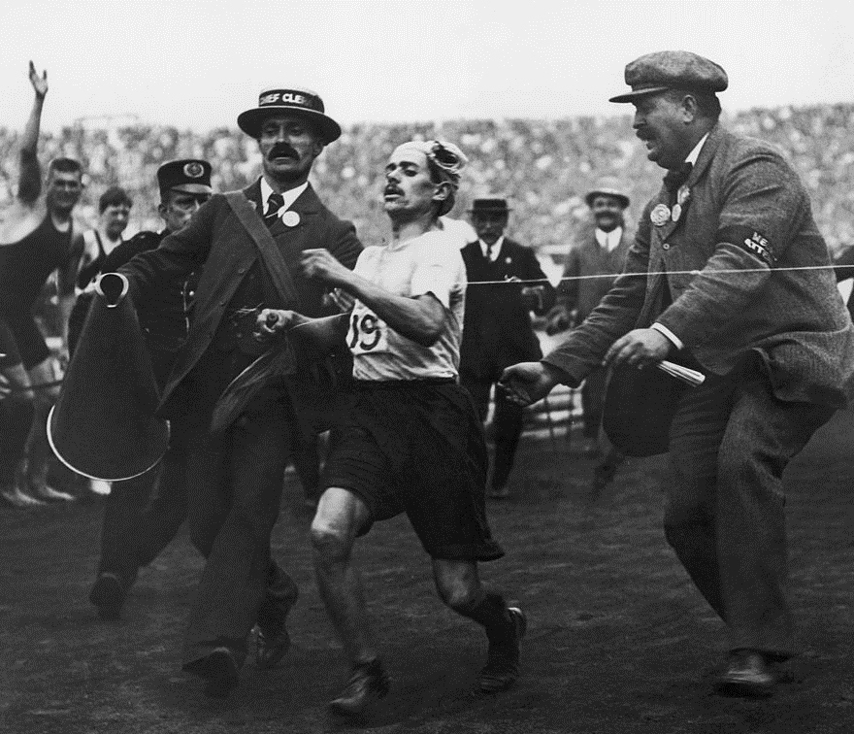
Olympic Games in London, 24th July 1908. Dorando Pietri finishes first… Johnny Hayes awarded gold medal

Slide 13
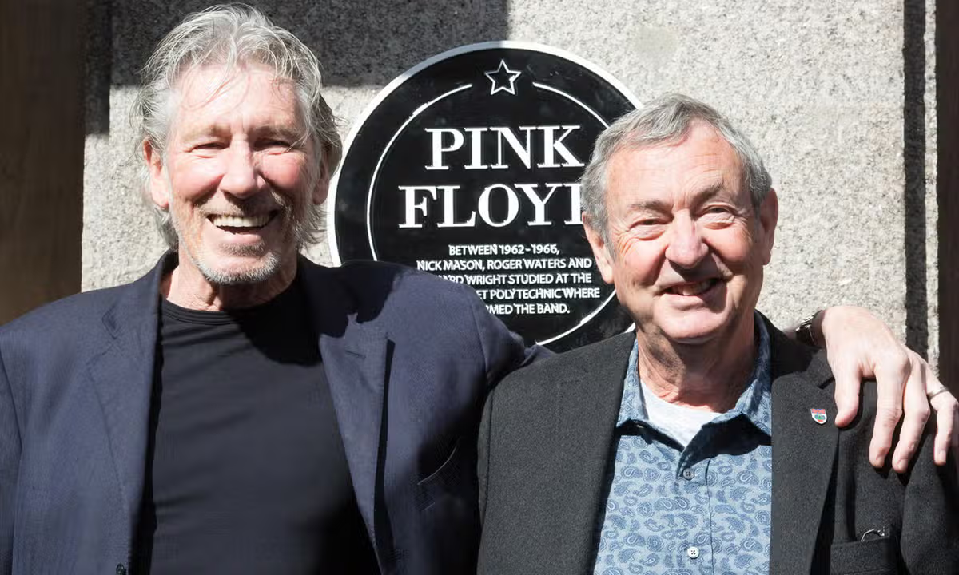
Architecture students Roger Waters, Nick Mason and Richard Wright formed Pink Floyd at the Regent Street Poly in 1965

Slide 14
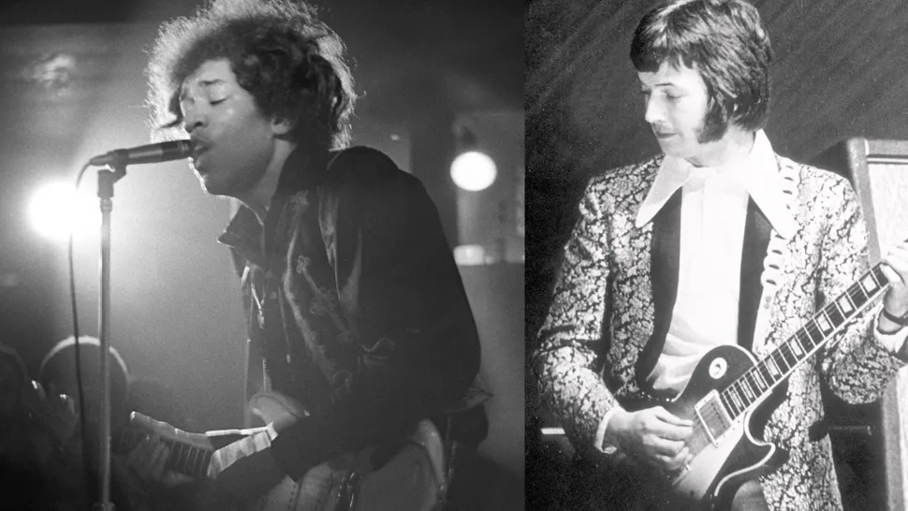
Jimmy Hendrix sits in with Cream (Eric Clapton and Ginger Baker) at a gig at Little Titchfield Street

Slide 15
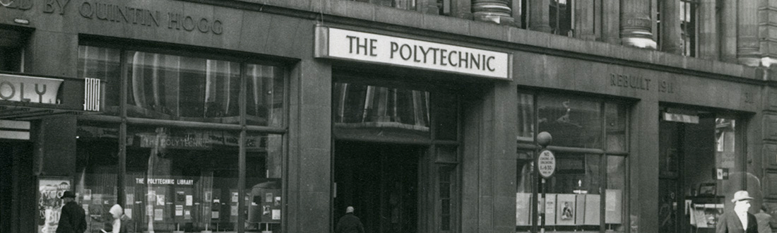
The Polytechnic of Central London 1970–92
The PCL was one of 30 new polytechnics formed in 1970 awarding degrees from the Council of National Academic Awards.

Slide 16
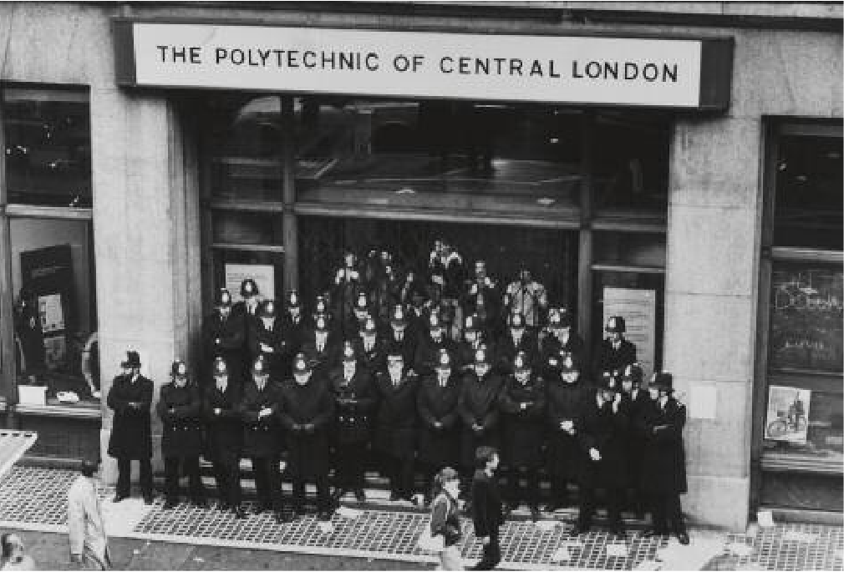
Notes:
The students occupied 309 Regent
Street in November 1981 for 12 days.
The action resulted in 12 arrests
after police first barricaded and
then stormed the building to end
the protest.

Slide 17
College of Liberal Arts and Science
College of Design, Creative and Digital Industries
Westminster Business School
1992- Present

Slide 18
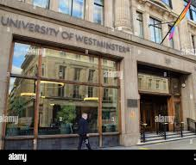
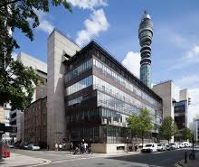
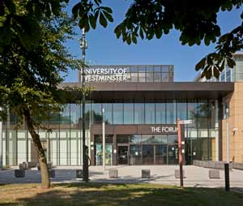
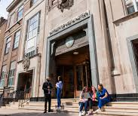
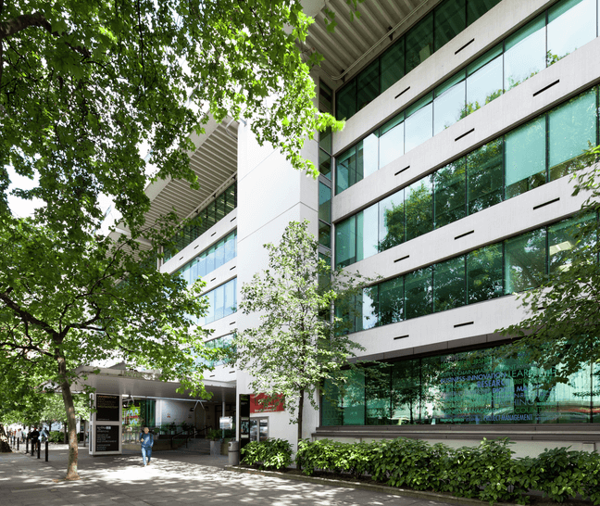
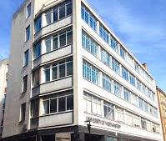
Regent Street
Regent Street
New Cavendish Street
Harrow
Little Titchfield Street
Marylebone Road
Wells Street

Slide 19
Our University
20,000 students
156 countries
2,000 academics
80 countries
Regent Street
Regent Street
New Cavendish Street
Harrow
Little Titchfield Street
Marylebone Road
Wells Street

Slide 20


Slide 21
Our Priorities
WELLBEING
INCLUSION
SUSTAINABLE DEVELOPMENT

