Slide 1
KASETSART UNIVERSITY SUMMER SCHOOL 2026 · DAY 17 · FUTURE CHANGEMAKERS
Becoming a
Sustainability Changemaker
Leadership, collaboration and future pathways.
Dr Farhang Morady
Director, Democratic Education Network (DEN) · University of Westminster, London
17 July 2026 · 09:30 to 11:30

Slide 2
Twelve days ago you were strangers
Look at what you have already done together. This is not a small thing.
1
Learned
2
Listened
3
Walked
SDGs, the Anthropocene, capitalism, AI, global governance and the glocal frame.
To Najmah on gender, health and coal extraction in Lahat, Sumatra.
The LERD Project at Phetchaburi. Mangroves planted, salt farms visited, blue crabs seen.
4
Analysed
5
Designed
6
Presented
The field data. Turned photographs and stories into patterns and problems.
In the studio, with people from four countries at your table.
Yesterday. Your first project as an international sustainability team.
Today we ask: what does it mean to keep doing this after you land back home?

Slide 3
What we will do in the next two hours
Four movements to send you home ready.
01
02
03
04
What is a sustainability changemaker?
Leadership for the long haul
Collaboration and networks
Future pathways
Not a hero. Not a saviour. Something more useful, and more possible.
Adaptive leadership, leading without authority, and the five capabilities.
Why the network is the point, and how to keep yours alive after Bangkok.
Six directions. Three time horizons. And what to do on Monday.

Slide 4
Before we begin
"When you land back home in Jakarta,
Manila, Hanoi, Hong Kong, and Beijing,
what is the first thing you will do differently?"
1
Turn to someone new
2
Then write it down
Not the person you have sat next to all fortnight. Someone else. Two minutes each.
One sentence. Fold it. Keep it in your pocket for the flight home.

Slide 5
PART 01
What is a sustainability changemaker?
Not a hero, not a saviour, not an entrepreneur alone.

Slide 6
Defining a changemaker
The word is used loosely. Let us make it useful.
A WORKING DEFINITION
"A sustainability changemaker is a person who, from within their own community, takes responsibility for reshaping the relationships, practices and systems that produce harm, in the direction of care."
FIVE FEATURES OF THIS DEFINITION
1
From within
2
Takes responsibility
3
Reshapes systems
4
In the direction of care
5
A person
You do not need to be an outsider to change things. Insiders have more traction.
Choice, not calling. Voluntary, not appointed. The choice can be made any Monday.
The work is not to help. It is to change what makes help necessary.
Care is not a word for nurses. It is a design criterion for institutions.
Not a saint, not a hero. A person, with weaknesses, tired evenings and second thoughts.

Slide 7
Three domains of change
Changemakers work on themselves, their community and the wider system, at the same time.
1
Self
2
Community
3
System
Habits, choices, learning, boundaries and self-care. The one place where change is fully within your reach.
The people you can look in the eye. Family, classmates, neighbours, colleagues, your Petchaburi hosts.
Institutions, laws, markets, cultures. Slow, large, resistant. But this is where the harm is produced.
THE WARNING
THE WARNING
THE WARNING
Skip this and you burn out fast.
This is where trust is built and tested.
Skip this and the community keeps drowning.

Slide 8
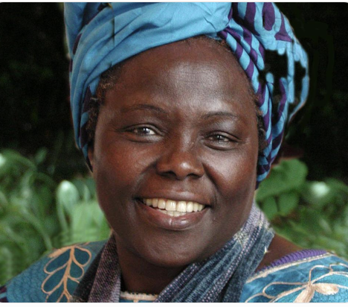
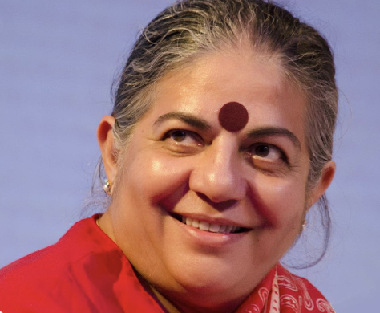
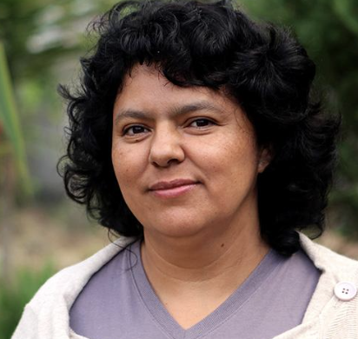
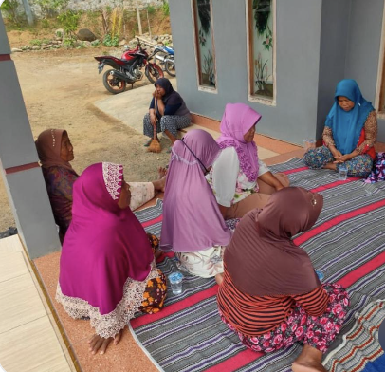
Some changemakers worth knowing
Four continents, four styles, one common pattern.
Wangari Maathai
Vandana Shiva
India, b. 1952
Kenya, 1940 to 2011
Physicist turned seed activist. Founded Navdanya to protect seed sovereignty and agroecology. Has trained hundreds of thousands of farmers to save their own seeds.
She has shaped global debates on:
Sustainable agriculture
Climate change
Corporate control of food systems
Founded the Green Belt Movement in 1977. Planted more than 51 million trees with rural women. Nobel Peace Prize 2004. Started with a single nursery, ended with a national political voice.
Trees restored degraded land. Women earned income by growing seedlings. Communities became more self-reliant. Citizens gained confidence to challenge poor governance
Berta Cáceres
Najmah and the Lahat mothers
Honduras, 1971 to 2016
Indonesia, present
Indigenous Lenca leader. Led a decade-long grassroots campaign that stopped the Agua Zarca dam on the Gualcarque River. Assassinated for her work. Goldman Environmental Prize.
Environmental protection is also about:
Human rights
Indigenous sovereignty
Gender equality
Community participation
Democratic decision-making
The case you already know. Feminist Participatory Action Research put research tools in the mothers' hands to reshape the mining conversation.
Why mothers?
Najmah acted as a facilitator:
organise meetings, encourage participation, coordinate data collection, support other mothers in learning research skills, present findings to decision-makers
The people most affected by a problem are often best placed to investigate it, understand it, and propose solutions.

Slide 9
Four myths to leave at the airport
These stories will slow you down. Do not carry them home.
✕
Myth: you need to be extraordinary
✕
Myth: you need permission
Wangari planted seedlings in a nursery. Bani chairs a Family Welfare Empowerment group. Ordinary hands, patient work.
Most changemakers in this room started without a title, a mandate or a budget. They started, and the mandate followed.
✕
Myth: it must be your full-time job
✕
Myth: you have to do it alone
Many of the people you have studied held day jobs while doing this work. You can too. Ten hours a week is not nothing.
You do not. The next three sections of this lecture are about why not, and how not to.

Slide 10
PART 02
Leadership for the long haul
Sustainability is a marathon. The leadership style must be too.

Slide 11
Adaptive leadership
The most useful leadership idea for sustainability work.
THE DISTINCTION
WHAT ADAPTIVE LEADERS DO
Technical problems.
Get on the balcony
Step back. See the whole dance floor before you re-enter it.
Experts can usually solve them.
Repairing a broken water pipe. Treating a common illness. Installing solar panels. Fixing a computer.
Regulate the heat
Not too cold (people ignore the problem). Not too hot (they panic).
Adaptive challenges.
Give the work back
Problems have no simple answer.
People must change: their behaviour, their attitudes, their habits,
and sometimes even their values.
Example: Climate change. Poverty. Gender inequality. Community conflict. Sustainable development.
.
Do not solve it for them. The community must own the solution.
Protect voices from below
The uncomfortable truth usually comes from the least powerful in the room.

Slide 12
Leading without authority
You will spend most of your life influencing people you cannot instruct. Start practising now.
1
Convene
2
Frame
3
Ask, do not tell
Bring the right people to the same table. Half of leadership is deciding who is in the room.
Name what is happening in words others can pick up and repeat. Words that spread do work.
Questions move a room further than statements. Especially uncomfortable questions.
4
Model the change
5
Give credit generously
6
Stay in the room
Do the small thing you want others to do. Take the bike. Ask the awkward question.
The more credit you give away, the more you get back. This is not rhetoric, it is arithmetic.
Half of authority is showing up when others leave. Presence beats speeches.

Slide 13
Five capabilities to keep growing
None of you will be strong in all five. Nobody is. That is why you need each other.
1
2
3
4
5
Personal
Relational
Cognitive
Practical
Ethical
Self-awareness, values, resilience, self-care.
Empathy, listening, holding difference, coalition-building.
Systems thinking, critical thinking, imagining alternatives.
Making things happen. Turning ideas into meetings, budgets, prototypes.
Integrity, courage, the willingness to lose sleep over the right thing.
Audit yourself. Then find the classmates who cover what you do not.

Slide 14
Failure, rest, resilience
The single most under-taught topic in sustainability leadership.
THREE HARD TRUTHS
PRACTICES THAT KEEP CHANGEMAKERS GOING
You will fail.
Small wins
Not once. Often. Every changemaker in your reading list did.
Track them. They accumulate. They matter more than you think.
A trusted circle
The problems will outlive you.
Two or three people who know your work and will tell you the truth.
Climate change, inequality, extractive industries. Your job is not to solve them. It is to move them.
Time away
Weekly rest. Annual holidays. Long walks. Non-negotiable.
Rest is political.
You cannot pour from an empty jug. Burnout is not a badge. It is a waste.
A practice that is not work
Music, cooking, sport, gardening, prayer. Something the world does not measure.

Slide 15
PART 03
Collaboration and networks
The network is the point. And it does not survive without care.

Slide 16
Why collaboration wins
Not a moral point. A structural one.
1
Problems cross borders
2
Complexity beats individuals
3
Networks outlast institutions
The rivers, supply chains, migrations and viruses that shape your life all cross national boundaries. So must the response.
No single mind holds the whole picture of a fishery, a slum, a coal seam. Collaboration is how you assemble the picture.
Governments change. Boards change. Universities change. Well-tended relationships survive all three.
4
Legitimacy travels through trust
5
Loneliness is dangerous
6
It is faster
You will need permission to speak in places you were not born in. Trust is the only currency that buys that permission.
The single strongest predictor of burnout in activists and researchers is professional isolation.
Collaboration feels slow at the start. It is faster over any horizon that matters.

Slide 17
Build unusual alliances
The alliances that shifted things in the last century were nearly always surprising.
SOME PAIRS THAT WORKED
HOW YOU BUILD THEM
Scientists · Indigenous elders
Share a problem, not an identity
In climate policy in the Arctic and the Amazon.
Alliances form around what you both want to change, not what you both are.
Nurses · Local mayors
Bring your specific gift
In public health responses to lead poisoning in mining towns.
Every partner needs something the other cannot get elsewhere. Be clear what yours is.
Farmers · Software engineers
In agroecology apps that respect local knowledge.
Move at the speed of trust
Nuns · Bankers
Under-promise. Over-deliver. Do not sprint before you have walked together.
In the shareholder activism that shifted fossil fuel policy.
Handle credit early
Mothers · Researchers
Agree upfront whose name goes on what. Ninety per cent of collapses start here.
In Najmah's Lahat, and everywhere FPAR travels.

Slide 18
Staying connected after Bangkok
Networks decay quickly. Yours does not have to.
1
Exchange more than emails
2
Set a first date
3
A shared document
Trade WhatsApp, Instagram, LinkedIn, or whatever else your group uses at home. Then actually message.
A group video call four weeks from today. Put it in the diary before you leave the room.
One place for your project notes, reading list, photos and follow-up ideas. Someone volunteers to be its keeper.
4
Write once a term
5
Introduce each other onward
6
Come back for something
Even a short reflection sent to your Summer School group counts. Frequency beats length.
The person you met here who most needs to know your cousin, your professor, your NGO contact. Make the introduction.
A visit, a co-authored paper, a joint conference session. Give yourselves a reason.

Slide 19
DEN: an example already in the room
Democratic Education Network, University of Westminster, London. Active since 2016.
THE SHORT STORY
WHY IT SITS ON THIS LECTURE
A student-led community that treats research, teaching and public engagement as one continuous practice.
Almost everything we talked about this morning, DEN has been doing for nearly a decade.
Started with a small group of students and one supportive lecturer.
Grew through weekly working sessions, not through top-down planning.
Now connects universities in London, Bangkok, Beijing, Hanoi, Manila, Jakarta and beyond.
You are already inside this case, right now.
Leadership without authority: yes.
Bottom-up collaboration: yes.
Cooperation across borders: yes.
Failure, resilience and quiet rebuilding: also yes.
It is not the only model. It is a real one that survived, and that you can plug into on Monday.
The next slide breaks the three principles apart, with DEN as the worked example.

Slide 20
DEN through three lenses
Leadership. Bottom-up collaboration. Cooperation across distance. How DEN actually does each.
1
Leadership
2
Bottom-up collaboration
3
Cooperation across distance
Not committees.
Ideas start where the work is.
The network is the point.
•
Every year a new cohort of students takes charge of the international conference.
•
Weekly working sessions, not seminars. Whoever shows up sets the agenda that week.
•
Partner universities in Thailand, China, Vietnam, Indonesia, the Philippines, Turkey, Peru.
•
Older members mentor, do not command. The credit goes to whoever does the work.
•
Field trips, magazine issues and book chapters begin as student proposals.
•
Two-way exchange: DEN students travel, and international students come to London.
•
The founding director stays present, but decisions travel outward, not downward.
•
The role of staff is to unlock rooms, sign forms and defend space, not to prescribe outputs.
•
Shared publications, joint conferences, co-authored chapters and joint Model UN teams.
•
The leadership question is: who volunteers, who is trusted, and who follows through.
•
Anyone who wants to lead a project can, once they can name what they want and why.
•
Trust is built slowly, in person, and then held together by messages and small favours.
You are welcome inside all three columns. On Monday, pick one and take one step.

Slide 21
PART 04
Future pathways
Six directions. Three time horizons. And what to do on Monday.

Slide 22
Six pathways beyond graduation
Most sustainability careers weave between two or three of these over a lifetime.
1
Research
2
Policy
3
Civil society
Academia, PhD, applied research. Turning fieldwork into peer-reviewed knowledge that shifts policy.
Ministries, local government, UN and multilateral bodies. Writing the rules that shape everyone else's choices.
NGOs, advocacy, movement-building. Holding power to account and organising ordinary people.
4
Business
5
Community
6
Creative
Social enterprise, ESG, sustainability roles. Reshaping companies from the inside, or building new ones.
Cooperatives, community energy, urban farming, mutual aid. The unglamorous, essential grassroots.
Journalism, film, art, communications. Changing the story so the other five paths become possible.

Slide 23
Three time horizons
Think in three timeframes at once. Overweight the short one. Never lose sight of the long one.
1
Six months
2
Two years
3
Ten years
Keep this network alive.
Find your niche.
Shape something.
•
Publish one reflective piece.
•
Build a body of work others can point to.
•
Have one thing you can call your contribution.
•
Deepen one skill you started here.
•
Take one leadership role, however small.
•
Have mentored people who will outdo you.
•
Book two coffees with people you met.
•
Find one mentor. Become one to someone else.
•
Sit on one board or committee that matters.
•
Say yes to one small opportunity.
•
Travel once, on purpose, to learn.
•
Leave a place better than you found it.

Slide 24
Career and calling: hold both loosely
The rent still has to be paid. The soul still has to be fed. Do not confuse the two.
CAREER
CALLING
What pays your rent.
What feeds your soul.
Choose a role that keeps you close to the work you care about, even sideways.
Learn what your employer teaches you. Money and skills are both currencies.
Change jobs every three to five years for most of your twenties. Loyalty comes later.
A boring day job with time for your calling is often better than the reverse.
Look for the thing you would do without being paid.
It rarely arrives fully formed. It emerges from many small experiments.
It might be inside your day job. It might be entirely separate. Both are fine.
Callings evolve. The one you name at twenty five is not the one you serve at forty.

Slide 25
What to do on Monday
Not next year. Not next summer. Monday. When you are still tired from the flight.
1
Write one page
2
Send three messages
About what you learnt here. To a friend, a professor, or your student magazine. Do it before you unpack.
To three people you met. Not "nice to meet you." Say what you took from the conversation.
3
Sign up for one thing
4
Book two coffees
A society, a course, a volunteer role, a reading group. Anything that keeps you moving.
With people at your own university you should know but do not.

Slide 26
Four commitments to carry home
If you remember nothing else, remember these.
1
Start where you are
2
Do not go alone
You do not need permission, funding or fame. You need a small first step, taken today.
The network is the point. Find your people, keep them close, work with them for years.
3
Take care of yourself
4
Change what you can
Rest is political. Burnout is not a badge. You are more useful whole than you are heroic.
Not everything. Not the whole system. Change the piece within reach. Then reach further.

Slide 27
Stay in touch
You are welcome in London, in the network, and in whatever comes next.
AN OPEN DOOR
Write for our online magazine, insidewestminster.co.uk. We publish student voices from around the world, and edit warmly.
Contribute a chapter to next year's book. The theme is being shaped now. Yours can be one of the voices in it.
Come to next year's DEN annual conference in London. Bring your Summer School project.
STAY IN CONTACT
Dr Farhang Morady · Director, DEN · University of Westminster
farhangmorady.net · insidewestminster.co.uk · https://democraticeducationnetwork.net/
Add me on LinkedIn. Message me. Tell me what you did next.

Slide 28
Thank you.
Find what needs changing in the world. Care about it deeply. Act on it with passion. That is where transformation start.
Dr Farhang Morady · Director, Democratic Education Network · University of Westminster
farhangmorady.net · https://democraticeducationnetwork.net/. insidewestminster.co.uk

