Slide 1




Gender, Health, and Resource Extraction in Southeast Asia:
Lessons from Mothers in a Sumatran Coal Mining Case Study
Najmah
Lecturer in Faculty of Public Health, Indonesia
Research Fellow in International Institute for Asian Studies, Leiden University, Netherland
Visiting Lecturer in Faculty of Social Science, Kasetsart University, Thailand The Asia in the World Fellowship
najmah@fkm.unsri.ac.id | najmahn@vuw.leidenuniv.nl

Slide 2
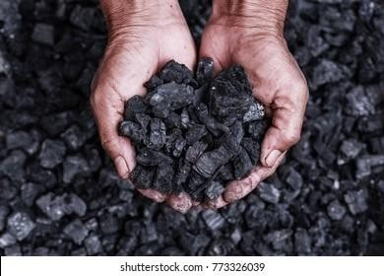
Imagine of you are living in villages with treasures, that they call COAL

Slide 3
Write your feelings

Slide 4
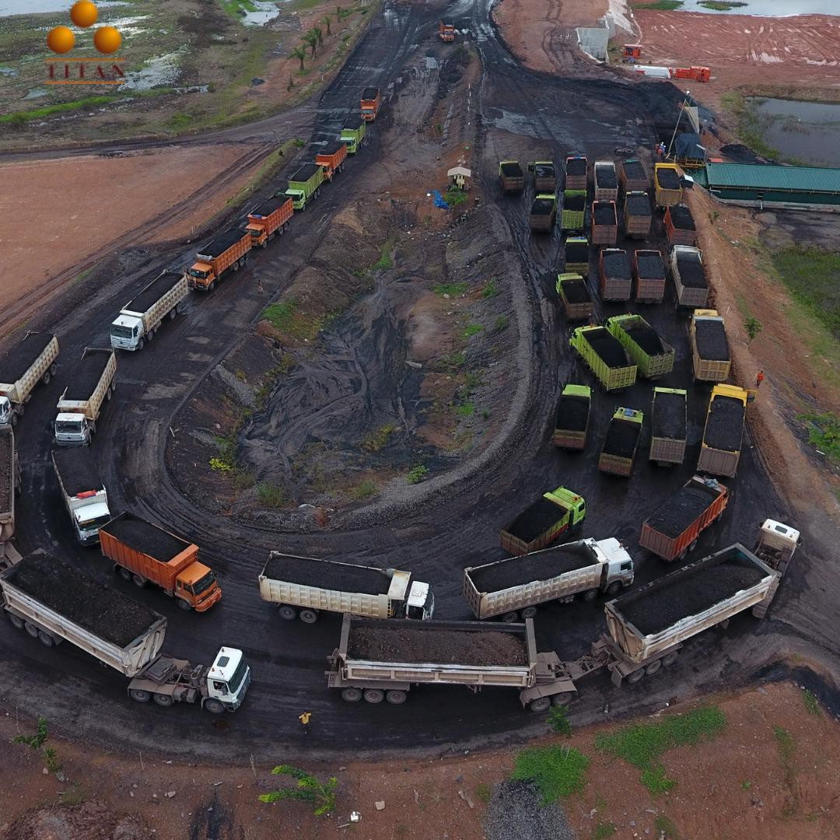
Source: https://www.titaninfra.com/jalan-tol-khusus-batu-bara-113-km-menjadi-pusat-transportasi-tambang-batu-bara-di-sumsel/

Slide 5
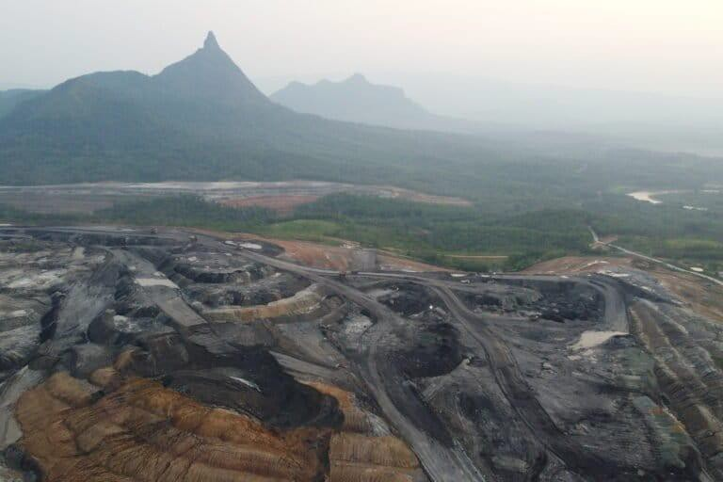
Source: https://mongabay.co.id/2023/11/29/kala-tambang-batubara-kuasai-sumsel-lingkungan-rusak-hidup-warga-makin-susah/

Slide 6
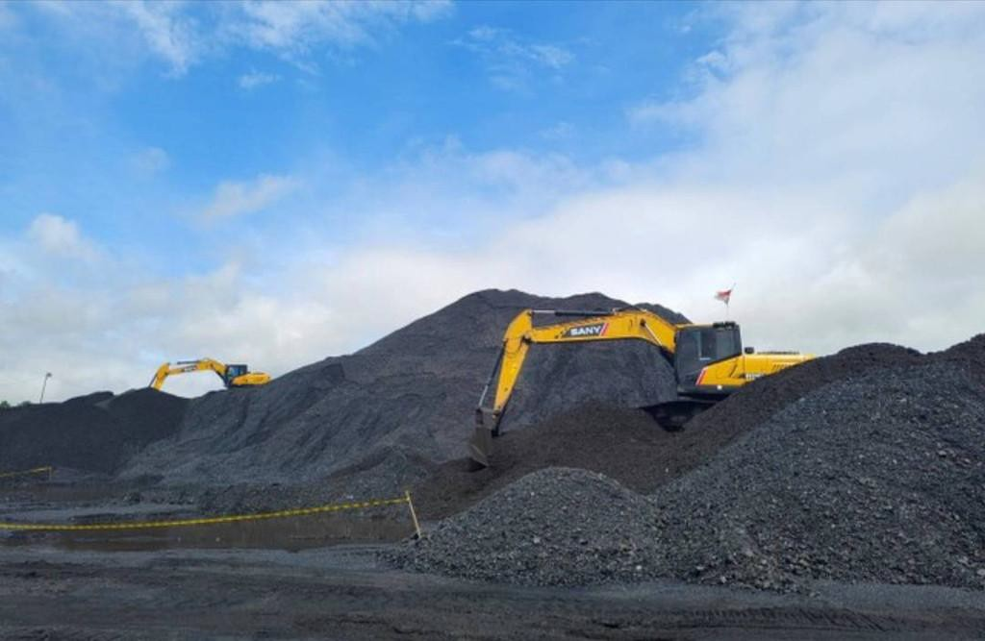
Sumber: https://kumparan.com/urbanid/debu-batu-bara-jadi-ancaman-serius-bagi-kesehatan-warga-lahat-2489n1TPJVW/3/gallery/1

Slide 7
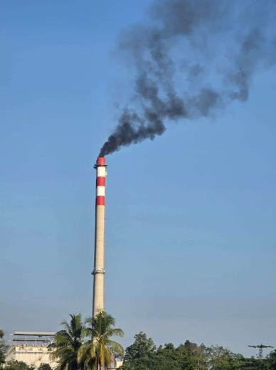
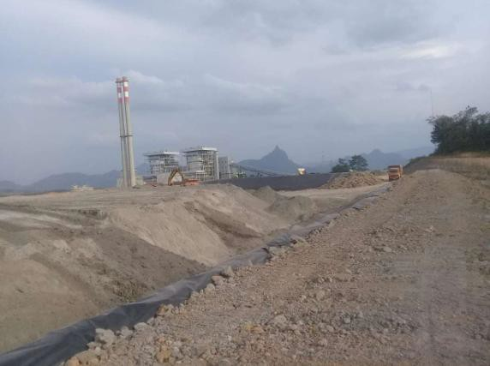

Slide 8
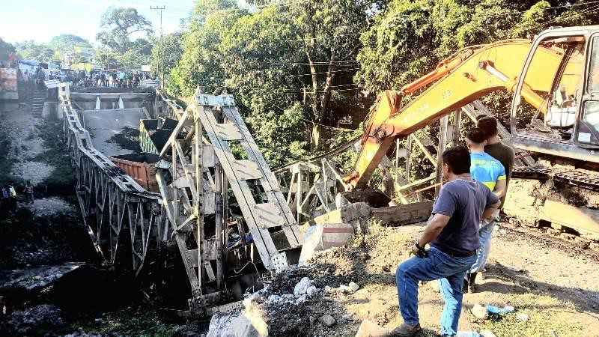

Slide 9
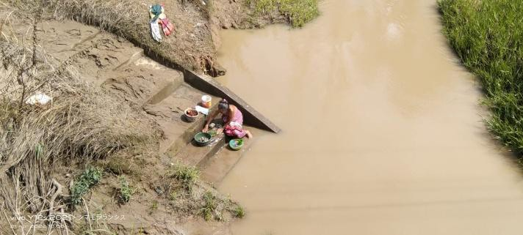

Slide 10
VIDEO

Slide 11
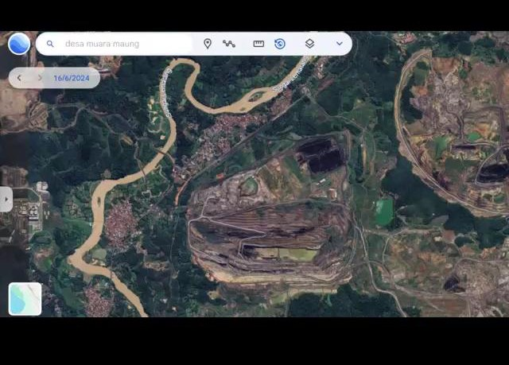

Slide 12
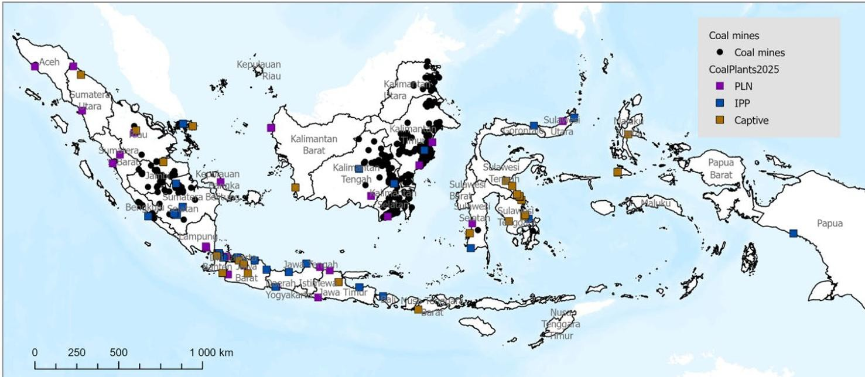


Indonesia’s coal mines and coal plants

Slide 13
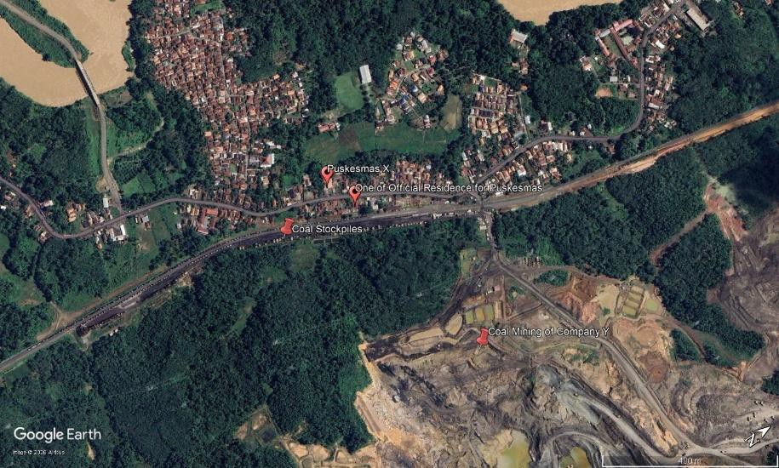
VILLAGE
OFFICIAL RESIDENCES FOR COMMUNITY HEALTH WORKERS
COAL STOCKPILES
COMMUNITY HEALTH CENTRES
COAL MINING SITES

Slide 14
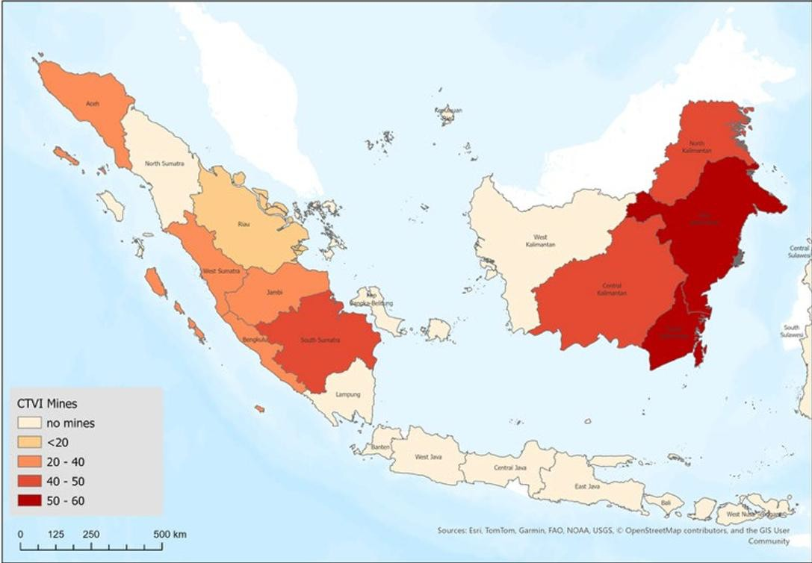
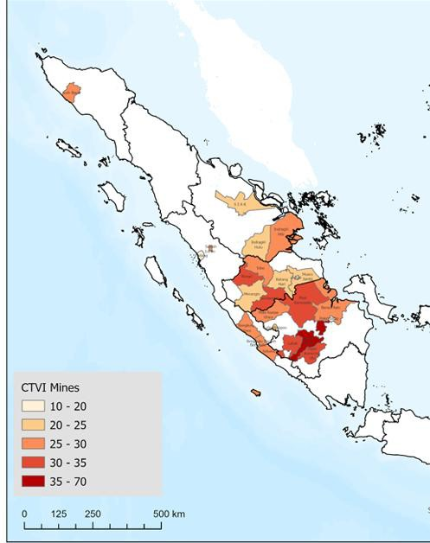
Research setting
Oktay, Tas, Emcet , Ezqi Canpolat, Megan Cole, Abidah Setyowati, and Jasmina Woodhouse. 2025. "Spacial Analysis of Coal Transition Vulnerability in Indonesia." World Bank.
Accessed 03 December. https://openknowledge.worldbank.org/entitie s/publication/49a386a9-5a41-4302-bf34-a8644807127b.

Slide 15
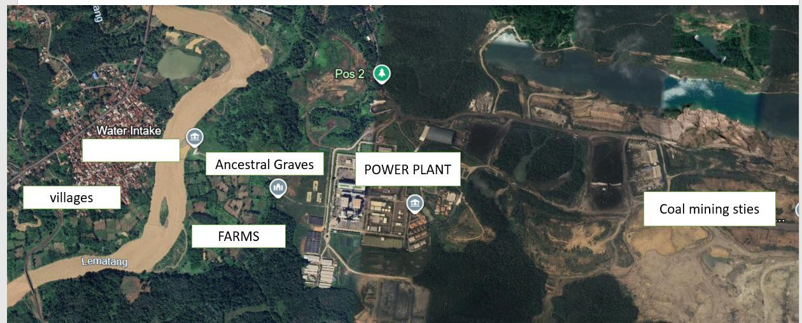

Slide 16
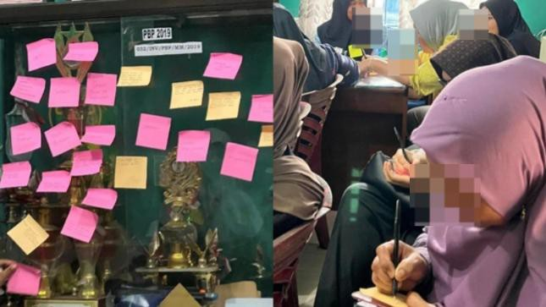
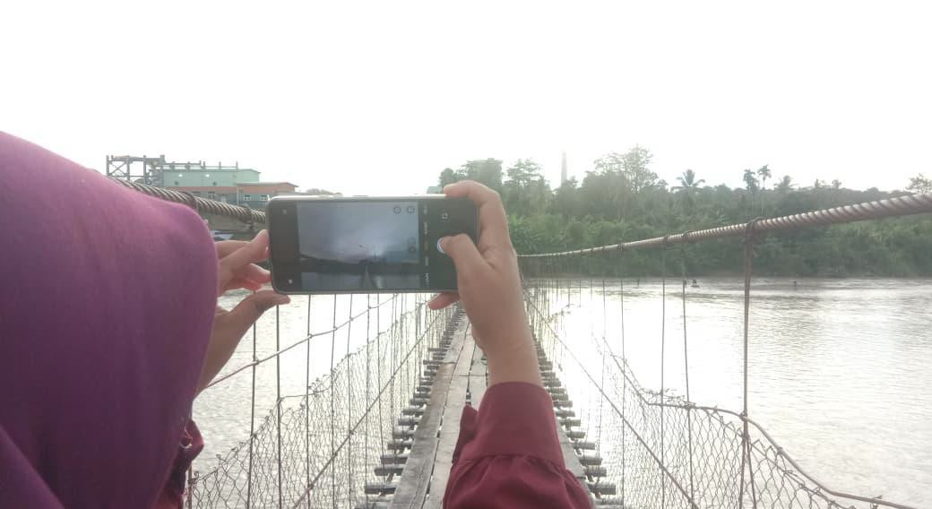
Research Methodology
Aims: How mothers are specifically impacted by mining activities
Research Methodology:
a Feminist Participatory Action Research (FPAR) framework
Utilizing Participatory Visual Methods, we provided 30 mothers across three
villages in
Lahat with the tools to document their own lives
through
and
photography, storytelling,
collective mind-mapping, go-along interview and FGD.

Slide 17
Environmental Harms Coal dust in homes and health services The Green landscape is buried in Ash From Childhood Rivers to Toxic Floods | Psychosocial Harms: Solastalgia "worried" "uneasy" “uncomfortable"
Disempowered Agency Digging One Hole to Fill Another The Gap Between Collaborative Vision and Institutional Silence

Slide 18

Environmental harms

Slide 19
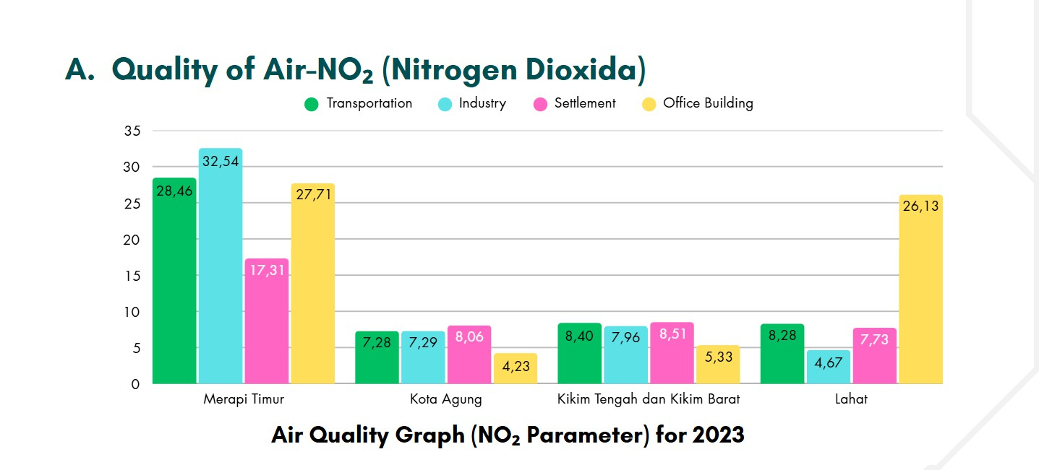

Slide 20
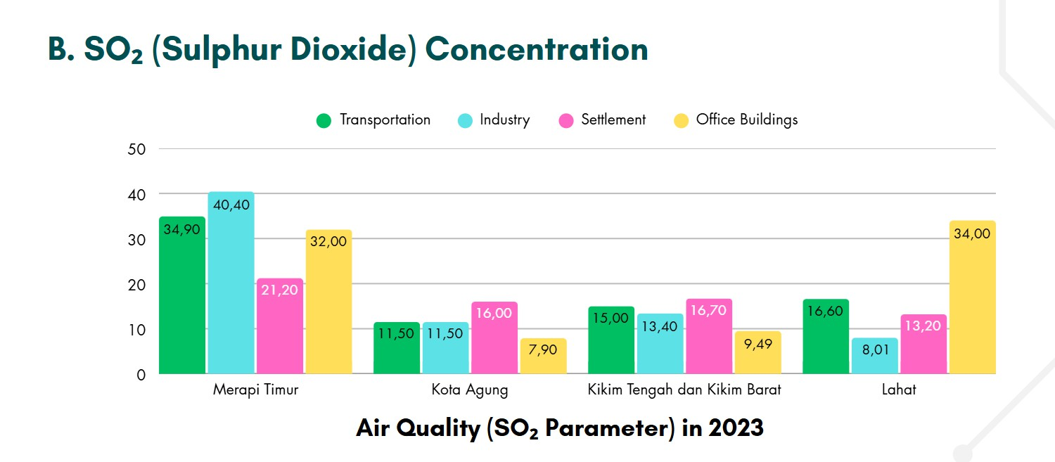

Slide 21
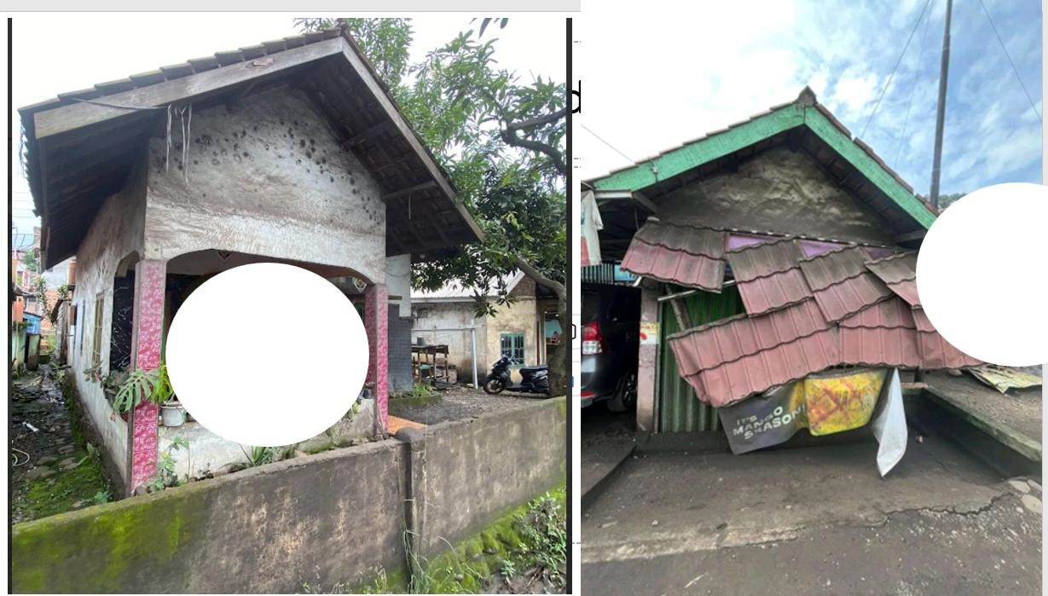

Slide 22
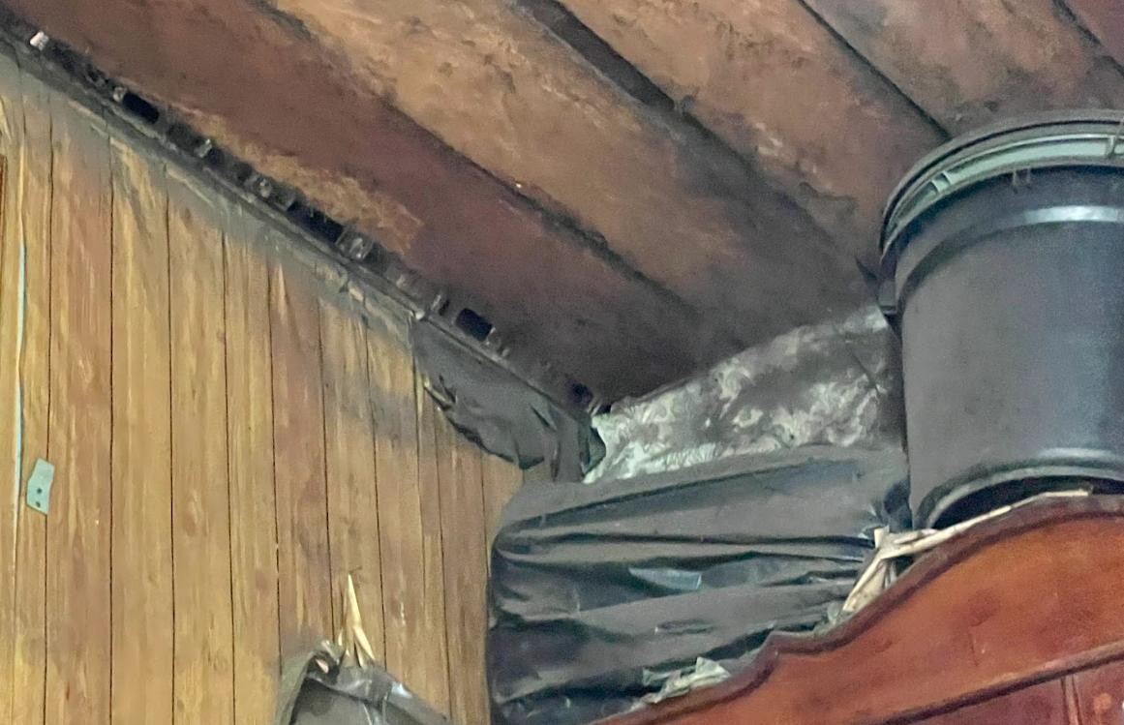

Slide 23
"As a result of the impact of coal hauling transport, dust sticks to residents' houses on the outskirts of the highway and there are many accidents, collapsed houses and so on. In addition, houses on the side of the road are always closed and the colours of the houses are always shabby (Ana, Interview)

Slide 24
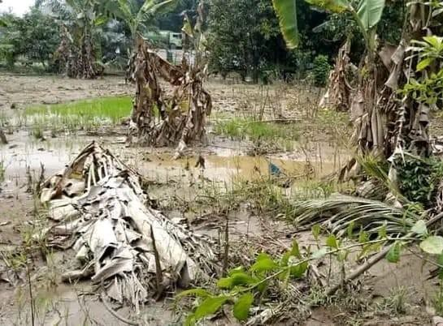

Slide 25
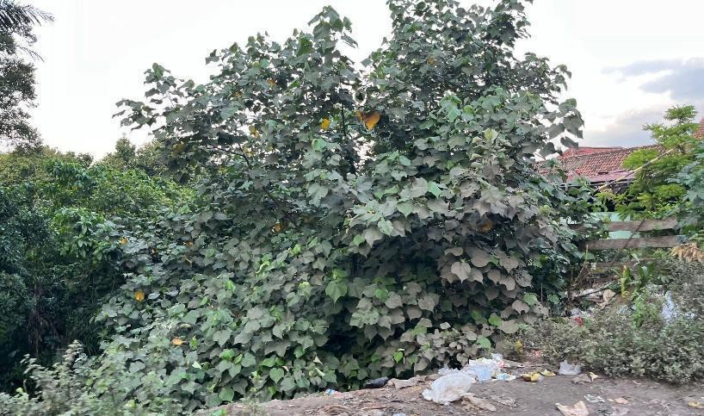

Slide 26
Cinta, a farmer aged 50 who was gardening in her garden near the Z power plant. She is originally from one village, and we asked her about her plantation near the coal power plant. She complained that her garden always failed to produce a harvest. Her garden contained rice, vegetables, corn and bananas, but she said that the plants would not develop or grow. We also saw for ourselves that the leaves there were covered in ash from the power plant. It turned out that it was not only Cinta farm that was experiencing this; many other farms were too. (Cinta, interview)

Slide 27
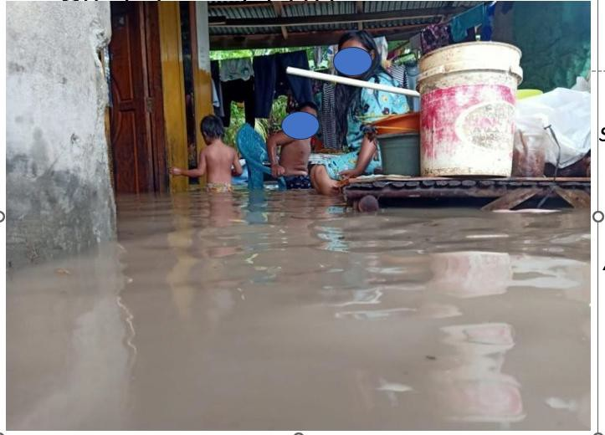

Slide 28
Water and Flood
"Joy during the flood – smiles and laughter forced by the unexpected arrival of floodwaters. No one knows whose fault it is... All that remains is to wait and hope." (Hana, FGD with NGO workers)
The company has built a big embankment, so flooding isn’t as bad now. But still, without reforestation efforts, it will be troublesome. (FGD with stakeholders)

Slide 29
Psychosocial Harms: Solastalgia
Solastalgia—the "distress produced by environmental change impacting people while they are directly connected to their home environment"—and eco-anxiety, a chronic fear of environmental catastrophe (Albrecht et al. 2007).

Slide 30
"When they were children, they could take drinking water from the clear river... they could fish and swim. Now, the water is murky, the wells are oily and turning black." (Mira, FGD with mothers, 2025).

Slide 31
Psychosocial Harms: Solastalgia
Worried about the health impacts on children and family.” | “We feel uncomfortable with the environmental pollution caused by the mining.” | “We hope the coal dust in the village can be reduced.” | “Discomfort from dust, and the river water has become dirty.”
“Feelings of concern about the health impacts on our children and family.” | “We hope the village around the mining area can progress and develop, even though it’s surrounded by the company.” | “We feel uneasy with coal trucks passing on the main road because they often cause accidents.” | “Uncomfortable with coal dust and the hot, stinging air coming from the mining area.”

Slide 32
Disempowered Agency
Digging One Hole to Fill Another
Alhamdulillah, now we can afford a motorcycle... But much of the money also goes to medical expenses. It feels like digging one hole to fill another, Ma’am." (Dani, informal Interview)
Yes, it's true, my husband now has a job, and the kitchen keeps running. But my heart still feels uneasy. The children get sick so easily these days-coughs and colds, because of the dust everywhere. Our village used to be cool and fresh, but now it feels so hot (Intan, FGD with mothers)

Slide 33
How about from economic Perspectives
Rasyida Pertiwi

Slide 34
Reflection and Discussion

Slide 35
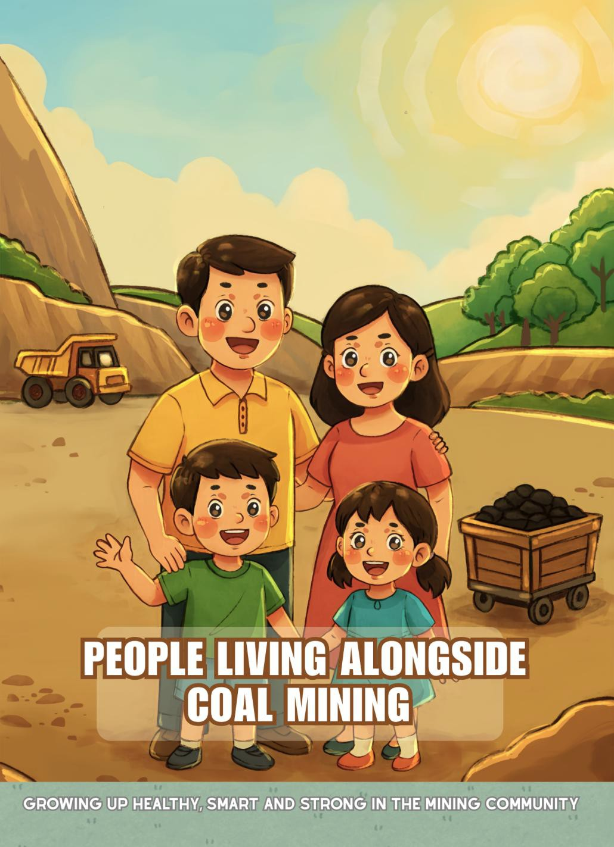
People living alongside coal mining
Pro and Cons

Slide 36

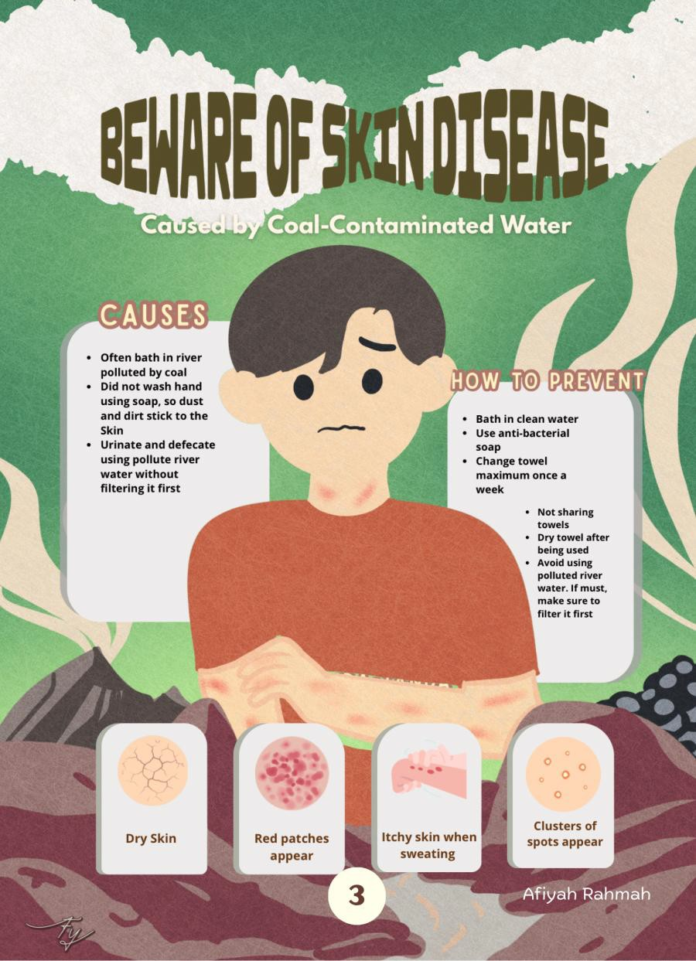
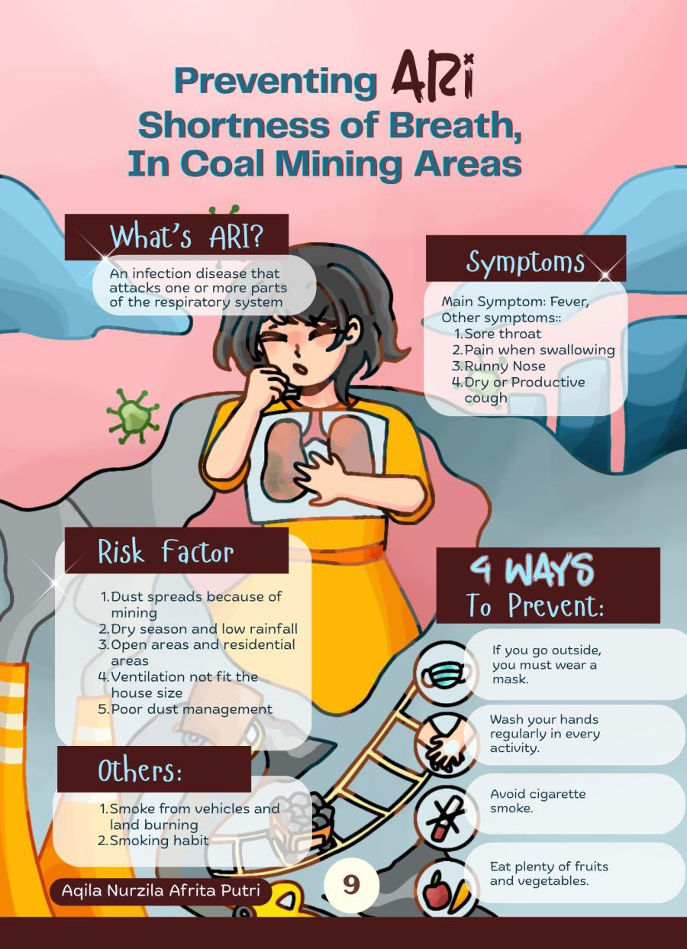

Slide 37
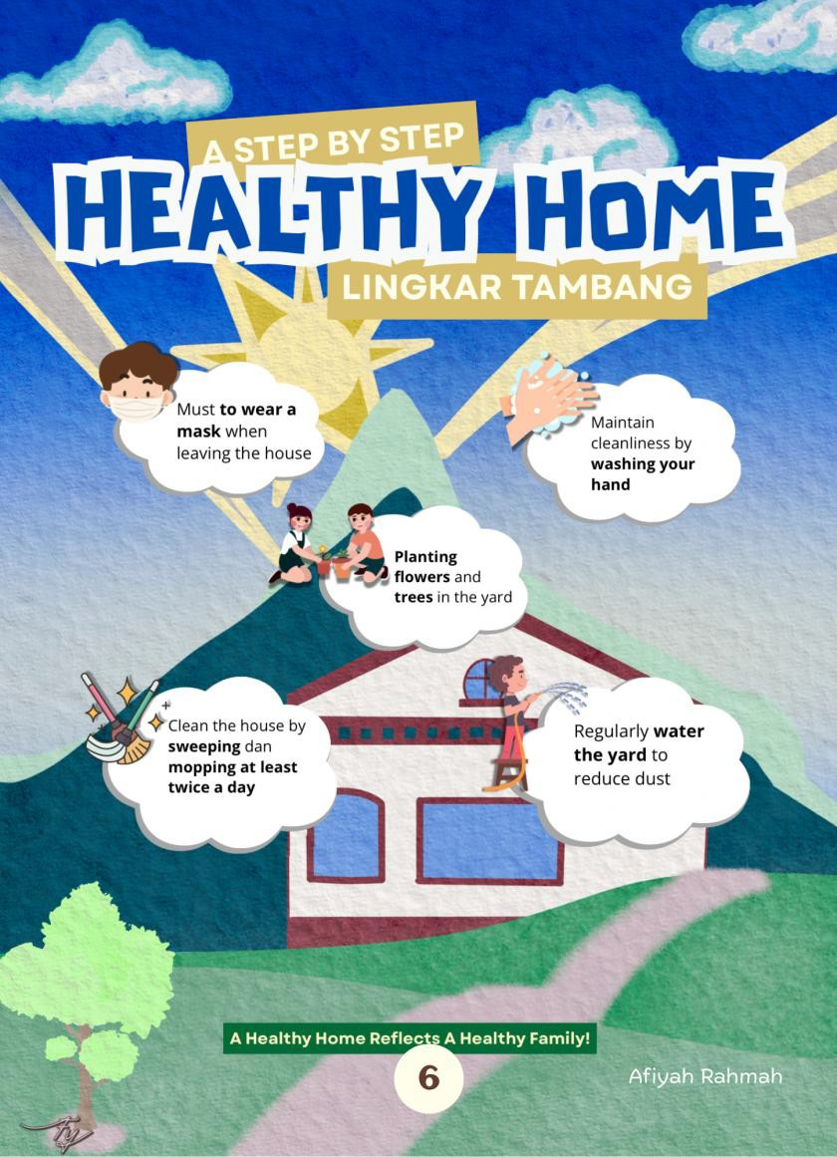

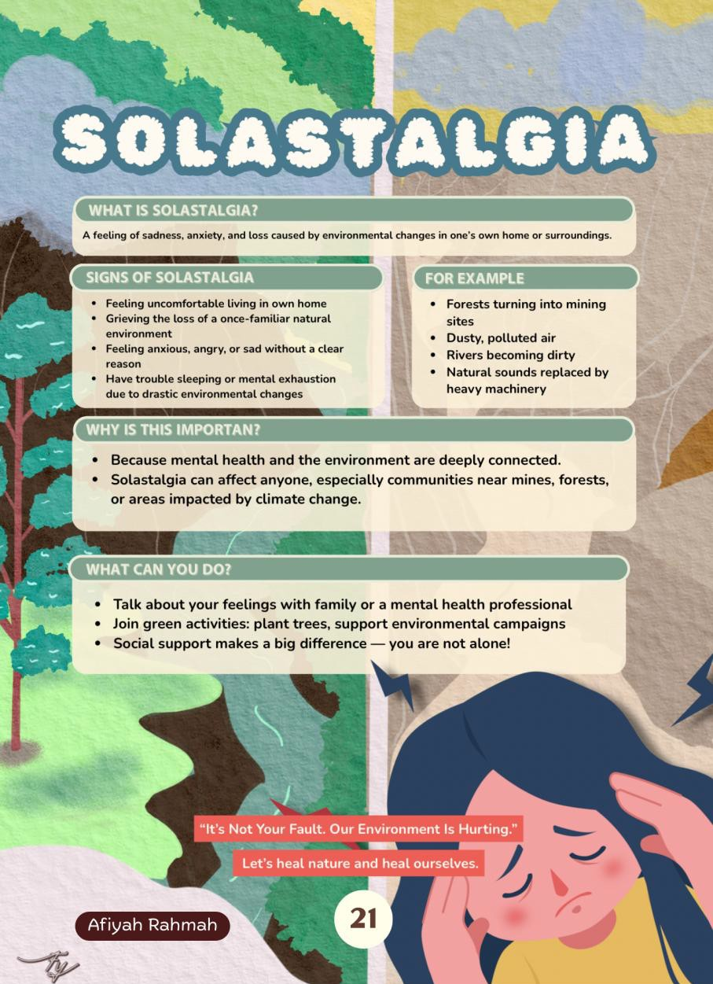

Slide 38
Co-Designing Sustainable Futures: Mothers Advocating for Child Health and Alternative Economies in Village X

Slide 39
Mother’s hope
All parties must cooperate, from sub-district heads to village heads to companies. They must provide input and provide benefits for each other in the future. If they continue mining without reforestation, our village could be destroyed and sink. If they unite-
-companies, sub-district heads, village heads, and residents--after mining, they reforest the land so that it remains green, so the key is collaboration. If the land is mined, it must be filled back in. So that’s the importance of collaboration. There must be coordination with the company, the sub-district head, the village head, and the
residents (Bani, FGD with mothers in Family Welfare
Empowerment)

Slide 40
Mother of the Black Dust
In Lahat, the promises of prosperity shine bright as coal, A temporary mask that hides the erosion of the soul.
Where community health and agency are traded for a season,
And mothers stand as frontline guards, providing every reason
To fight the costs, both biological and deep within the mind,
An industry that takes the wealth, and leaves the women all behind.
The cycle turns: we dig one hole just to fill another’s space,
And economic gains are immediately spent in a futile race
To heal the wounds of mining's rot, a decay that must be managed. For a just transition to begin, we must see what has been damaged.
We must move past the symbols, the empty, easy gesture,
And hand the mothers power now, to guide our lands’ semester, To planted trees, mandatory, where a simple fix won’t last.

